Slide 1

Baseball Exploratory Analysis
Project 1
Alec Banerji, Ashley Paillet, Grace Palmer, Devin Trapp, Ryan Vasquez

Slide 2
Proposal and Goals
What stats correlate most closely with scoring runs?
BA & OPS
What unexpected trends can we uncover?
HR & SB

Slide 3
Creating a Workable DataFrame
Cleaning
Renaming & removing columns
Refining timeframe by removing rows
Creating columns
Calculating averages to compare stats
Calculating correlation
Identifying strong positive and negative correlations

Slide 4
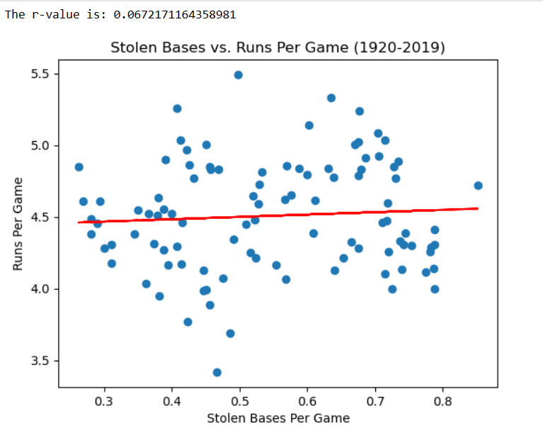
Scatter Plots & Linear Regression

Slide 5
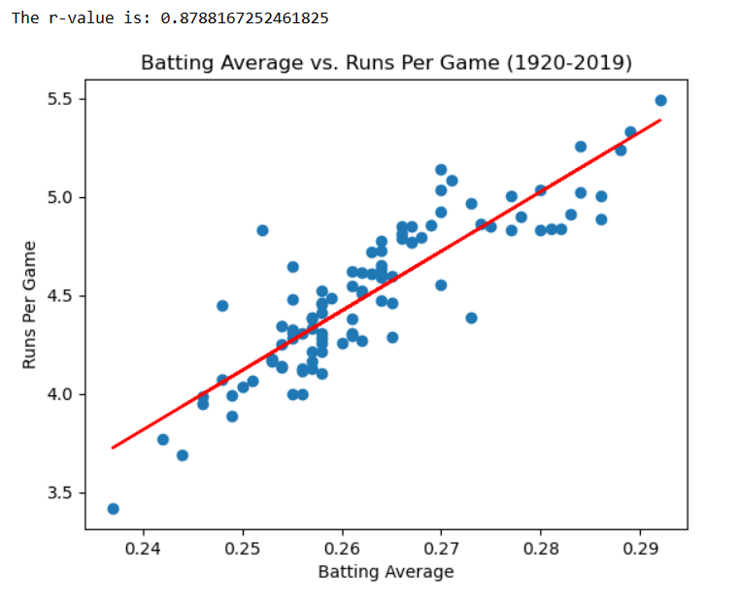
Scatter Plots & Linear Regression

Slide 6
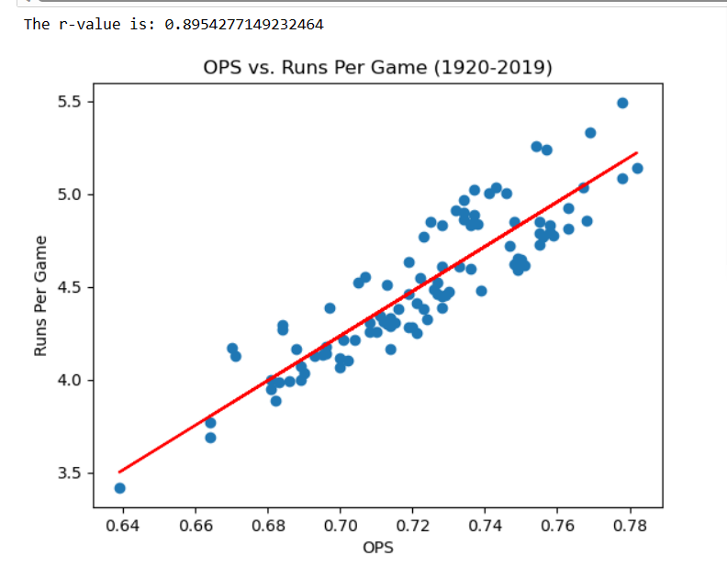
Scatter Plots & Linear Regression

Slide 7
Analyzing by Decade
Binning
Reorganizing data by decade for further analysis and visualization

Slide 8
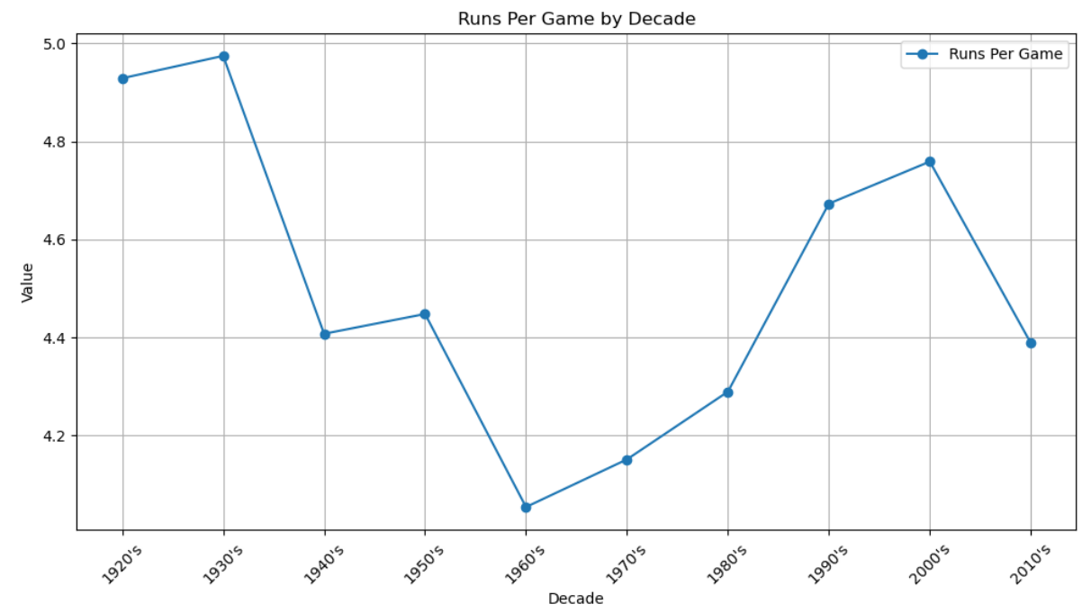
Analyzing by Decade

Slide 9
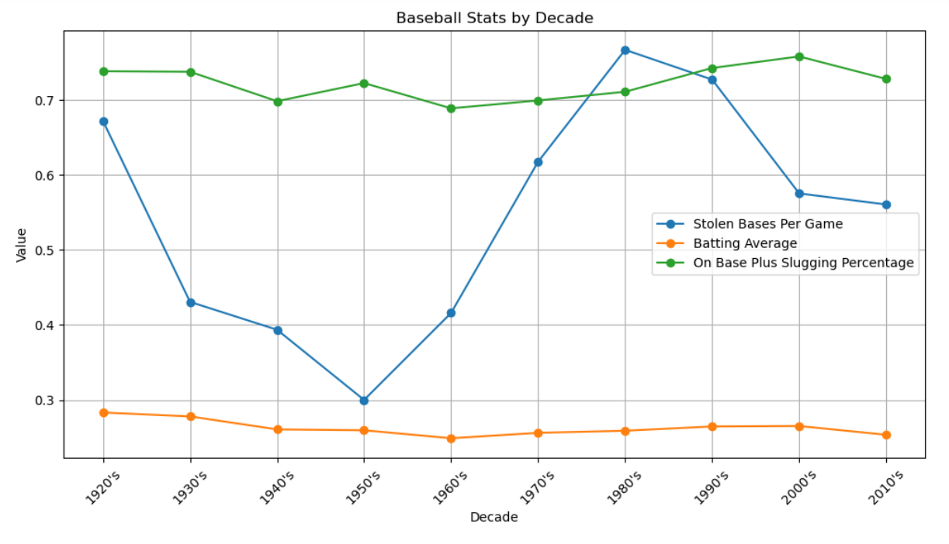
Analyzing by Decade

Slide 10
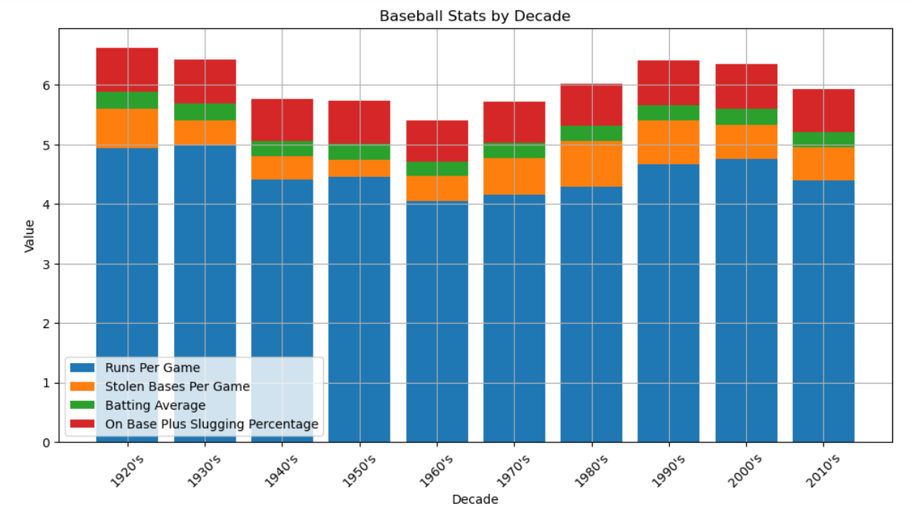
Analyzing by Decade

Slide 11
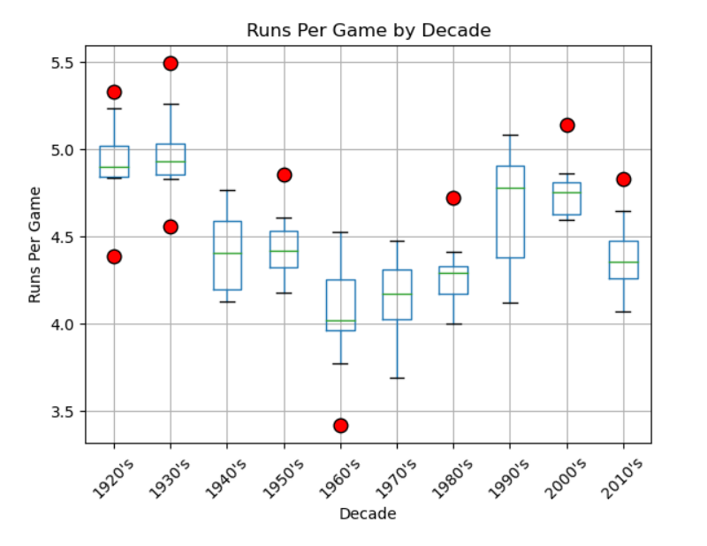
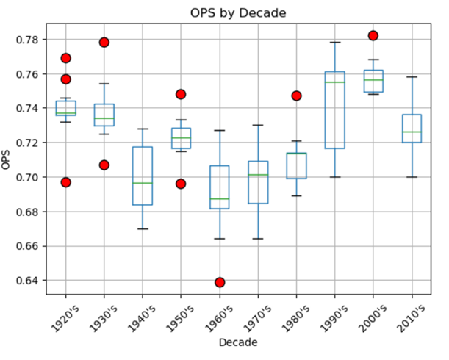
Box and Whisker Plots

Slide 12
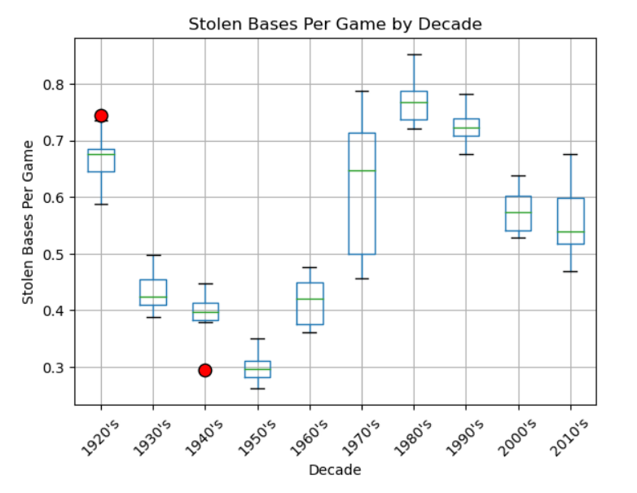
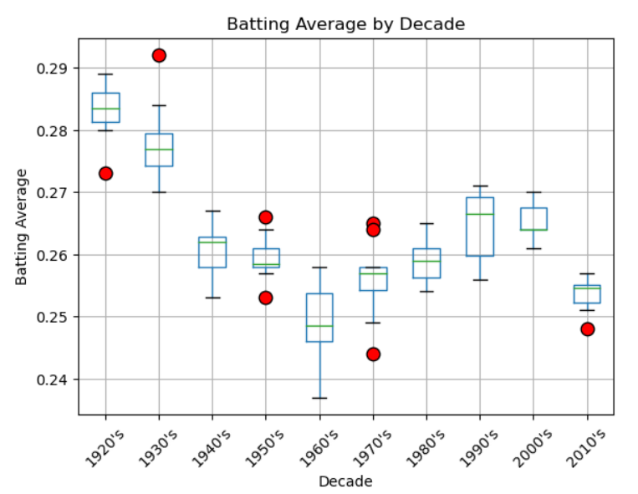
Box and Whisker Plots

Slide 13
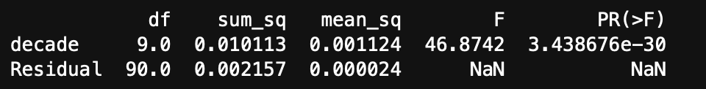
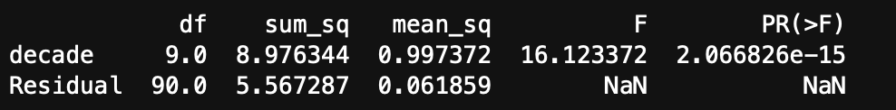
ANOVA
Batting Average by Decade
Runs per Game

Slide 14
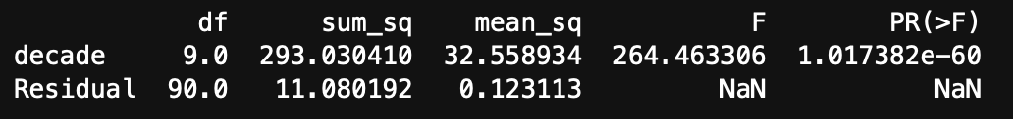
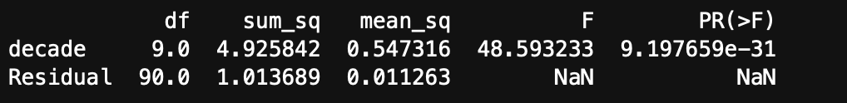
ANOVA
Strikeouts per Game
Homeruns per Game

Slide 15
Conclusion
BA and OPS correlate highly
Limitations of dataset
Further analysis opportunities
Source: https://www.baseball-reference.com/leagues/majors/bat.shtml

